Slide 1
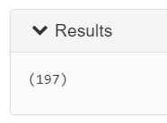
Q1: How many trading names do we have in the dataset?
--- Load the data and set the schema
data = load '/user/maria_dev/Amjad/BigDataCapstone/Tadawul_Stocks.csv'
using org.apache.pig.piggybank.storage.CSVExcelStorage(',', 'YES_MULTILINE', 'UNIX', 'SKIP_INPUT_HEADER') as
(symbol:int, name:chararray, trading_name:chararray, sector:chararray,date:chararray, open:float, high:float, low:float,
close:float, change:float, perc_Change:float, volume_traded:int, value_traded:int, no_trades:int, month:int, day:int, year:int);
-- Put only the trading names in relation
trading_name_column = foreach data generate trading_name;
-- Retrive only the unique trading names
unique_trading_name = distinct trading_name_column;
-- Group all the unique trading names so we could count them
grouping = group unique_trading_name all;
-- Count unique trading names
count_unique_trading_name = foreach grouping generate COUNT(unique_trading_name);
-- Display the result
dump count_unique_trading_name;

Slide 2
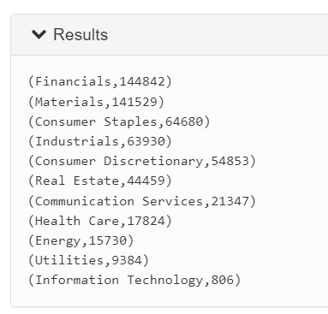
Q2: What is the frequency of all the sectors in the dataset?
--- Load the data and set the schema
data = load '/user/maria_dev/Amjad/BigDataCapstone/Tadawul_Stocks.csv'
using org.apache.pig.piggybank.storage.CSVExcelStorage(',', 'YES_MULTILINE', 'UNIX', 'SKIP_INPUT_HEADER') as
(symbol:int, name:chararray, trading_name:chararray, sector:chararray,date:chararray, open:float, high:float, low:float,
close:float, change:float, perc_Change:float, volume_traded:int, value_traded:int, no_trades:int, month:int, day:int, year:int);
--- Group by sector
group_sectors = group data by sector;
-- Count the sectors
count_sectors = foreach group_sectors generate group, COUNT(data.sector) as sectors_count;
--- Sort from highest to lowest
sorted_sectors = order count_sectors by sectors_count desc;
--- Display the result
dump sorted_sectors;

Slide 3
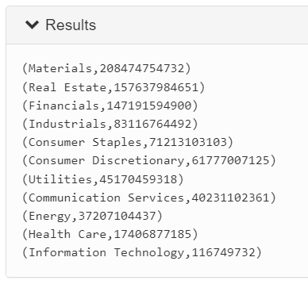
Q3: What is the total traded volume for each sector?
--- Load the data and set the schema
data = load '/user/maria_dev/Amjad/BigDataCapstone/Tadawul_Stocks.csv'
using org.apache.pig.piggybank.storage.CSVExcelStorage(',', 'YES_MULTILINE', 'UNIX', 'SKIP_INPUT_HEADER') as
(symbol:int, name:chararray, trading_name:chararray, sector:chararray,date:chararray, open:float, high:float, low:float,
close:float, change:float, perc_Change:float, volume_traded:int, value_traded:int, no_trades:int, month:int, day:int, year:int);
--- Group by sector
group_sectors = group data by sector;
-- Get the total volume trades for each sector
total_volume = foreach group_sectors generate group, SUM(data.volume_traded) as tradings;
--- Sort from highest to lowest
sorted_total_volume = order total_volume by tradings desc;
--- Display the result
dump sorted_total_volume;

Slide 4
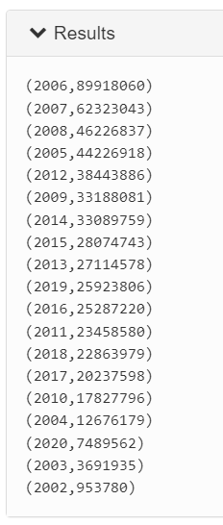
Q4: What is the total number of trades in each sector?
--- Load the data and set the schema
data = load '/user/maria_dev/Amjad/BigDataCapstone/Tadawul_Stocks.csv'
using org.apache.pig.piggybank.storage.CSVExcelStorage(',', 'YES_MULTILINE', 'UNIX', 'SKIP_INPUT_HEADER') as
(symbol:int, name:chararray, trading_name:chararray, sector:chararray,date:chararray, open:float, high:float, low:float,
close:float, change:float, perc_Change:float, volume_traded:int, value_traded:int, no_trades:int, month:int, day:int, year:int);
--- Group by the years
grouping = group data by year;
-- Get the total number of tradings for each year
total_tradings = foreach grouping generate group, SUM(data.no_trades) as tradings;
-- Sort from highest to lowest
sorted_tradings = order total_tradings by tradings desc;
--- Display the result
dump sorted_tradings;

Slide 5
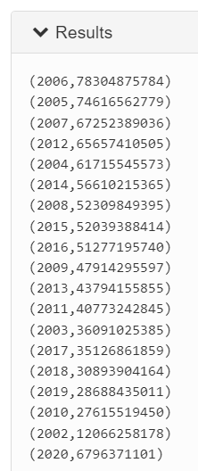
Q5: What is the total traded volume in every year?
--- Load the data and set the schema
data = load '/user/maria_dev/Amjad/BigDataCapstone/Tadawul_Stocks.csv'
using org.apache.pig.piggybank.storage.CSVExcelStorage(',', 'YES_MULTILINE', 'UNIX', 'SKIP_INPUT_HEADER') as
(symbol:int, name:chararray, trading_name:chararray, sector:chararray,date:chararray, open:float, high:float, low:float,
close:float, change:float, perc_Change:float, volume_traded:int, value_traded:int, no_trades:int, month:int, day:int, year:int);
--- Group by the years
grouping = group data by year;
-- Get the total number of volume traded for each year
total_tradings = foreach grouping generate group, SUM(data.volume_traded) as tradings;
-- Sort from highest to lowest
sorted_tradings = order total_tradings by tradings desc;
--- Display the result
dump sorted_tradings;

Slide 6
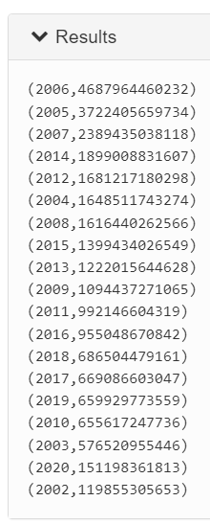
Q6: What is the total traded value in every year?
--- Load the data and set the schema
data = load '/user/maria_dev/Amjad/BigDataCapstone/Tadawul_Stocks.csv'
using org.apache.pig.piggybank.storage.CSVExcelStorage(',', 'YES_MULTILINE', 'UNIX', 'SKIP_INPUT_HEADER') as
(symbol:int, name:chararray, trading_name:chararray, sector:chararray,date:chararray, open:float, high:float, low:float,
close:float, change:float, perc_Change:float, volume_traded:int, value_traded:int, no_trades:int, month:int, day:int, year:int);
--- Group by the years
grouping = group data by year;
-- Get the total number of value traded for each year
total_tradings = foreach grouping generate group, SUM(data.value_traded) as tradings;
-- Sort from highest to lowest
sorted_tradings = order total_tradings by tradings desc;
--- Display the result
dump sorted_tradings;

Slide 7
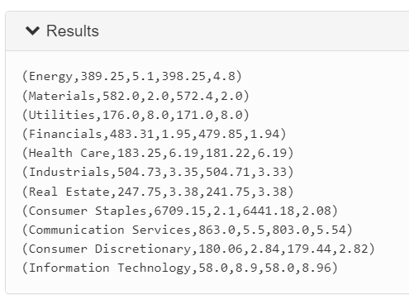
Q7: What was the highest and lowest opening and closing price in every sector?
--- Load the data and set the schema
data = load '/user/maria_dev/Amjad/BigDataCapstone/Tadawul_Stocks.csv'
using org.apache.pig.piggybank.storage.CSVExcelStorage(',', 'YES_MULTILINE', 'UNIX', 'SKIP_INPUT_HEADER') as
(symbol:int, name:chararray, trading_name:chararray, sector:chararray,date:chararray, open:float, high:float, low:float,
close:float, change:float, perc_Change:float, volume_traded:int, value_traded:int, no_trades:int, month:int, day:int, year:int);
--- Group by sector
group_sectors = group data by sector;
-- Get the maximum and minimum open and closing price for each sector
get_max_and_min = foreach group_sectors generate group, MAX(data.open), MIN(data.open), MAX(data.close), MIN(data.close);
--- Display the result
dump get_max_and_min;

Slide 8
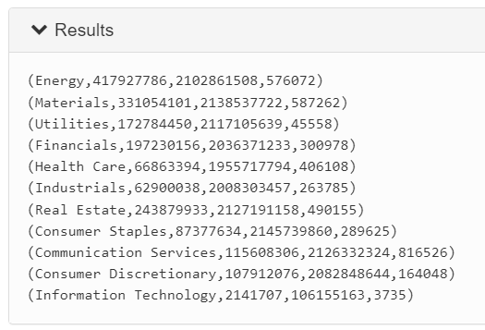
Q8: What was the highest volume, value and number of trades in every sector?
--- Load the data and set the schema
data = load '/user/maria_dev/Amjad/BigDataCapstone/Tadawul_Stocks.csv'
using org.apache.pig.piggybank.storage.CSVExcelStorage(',', 'YES_MULTILINE', 'UNIX', 'SKIP_INPUT_HEADER') as
(symbol:int, name:chararray, trading_name:chararray, sector:chararray,date:chararray, open:float, high:float, low:float,
close:float, change:float, perc_Change:float, volume_traded:int, value_traded:int, no_trades:int, month:int, day:int, year:int);
--- Group by sector
group_sectors = group data by sector;
-- Get the maximum voulme, value and number of trades for each sector
get_max = foreach group_sectors generate group, MAX(data.volume_traded), MAX(data.value_traded), MAX(data.no_trades);
--- Display the result
dump get_max;

Slide 9
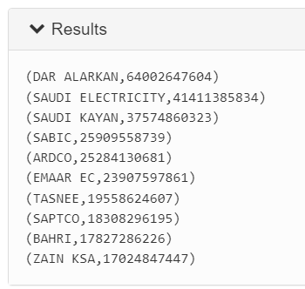
Q9: What are the top 10 companies with the highest volume trades?
--- Load the data and set the schema
data = load '/user/maria_dev/Amjad/BigDataCapstone/Tadawul_Stocks.csv'
using org.apache.pig.piggybank.storage.CSVExcelStorage(',', 'YES_MULTILINE', 'UNIX', 'SKIP_INPUT_HEADER') as
(symbol:int, name:chararray, trading_name:chararray, sector:chararray,date:chararray, open:float, high:float, low:float,
close:float, change:float, perc_Change:float, volume_traded:int, value_traded:int, no_trades:int, month:int, day:int, year:int);
--- Group by trading names
group_trading_name = group data by trading_name;
-- Get the total volume of trades
total_volume = foreach group_trading_name generate group, SUM(data.volume_traded) as volume;
--- Sort from highest to lowest
sorted_total_volume = order total_volume by volume desc;
--- Take the top 10 trading names
highest_total_volume = limit sorted_total_volume 10;
--- Display the result
dump highest_total_volume;

Slide 10
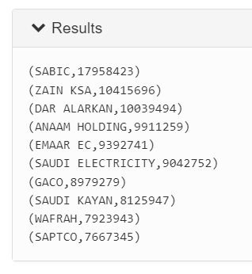
Q10: What are the top 10 companies with the highest number of trades?
--- Load the data and set the schema
data = load '/user/maria_dev/Amjad/BigDataCapstone/Tadawul_Stocks.csv'
using org.apache.pig.piggybank.storage.CSVExcelStorage(',', 'YES_MULTILINE', 'UNIX', 'SKIP_INPUT_HEADER') as
(symbol:int, name:chararray, trading_name:chararray, sector:chararray,date:chararray, open:float, high:float, low:float,
close:float, change:float, perc_Change:float, volume_traded:int, value_traded:int, no_trades:int, month:int, day:int, year:int);
--- Group by trading names
group_trading_name = group data by trading_name;
-- Get the total number of trades
total_trades = foreach group_trading_name generate group, SUM(data.no_trades) as trades;
--- Sort from highest to lowest
sorted_total_trades = order total_trades by trades desc;
--- Take the top 10 trading names
highest_total_trades = limit sorted_total_trades 10;
--- Display the result
dump highest_total_trades;

Slide 11
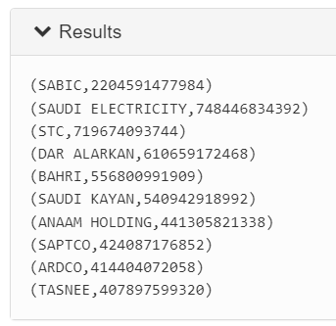
Q11: What are the top 10 companies with the highest value of trades?
--- Load the data and set the schema
data = load '/user/maria_dev/Amjad/BigDataCapstone/Tadawul_Stocks.csv'
using org.apache.pig.piggybank.storage.CSVExcelStorage(',', 'YES_MULTILINE', 'UNIX', 'SKIP_INPUT_HEADER') as
(symbol:int, name:chararray, trading_name:chararray, sector:chararray,date:chararray, open:float, high:float, low:float,
close:float, change:float, perc_Change:float, volume_traded:int, value_traded:int, no_trades:int, month:int, day:int, year:int);
--- Group by trading names
group_trading_name = group data by trading_name;
-- Get the total traded value
total_value = foreach group_trading_name generate group, SUM(data.value_traded) as value;
--- Sort from highest to lowest
sorted_total_value = order total_value by value desc;
--- Take the top 10 trading names
highest_total_value = limit sorted_total_value 10;
--- Display the result
dump highest_total_value;

Slide 12
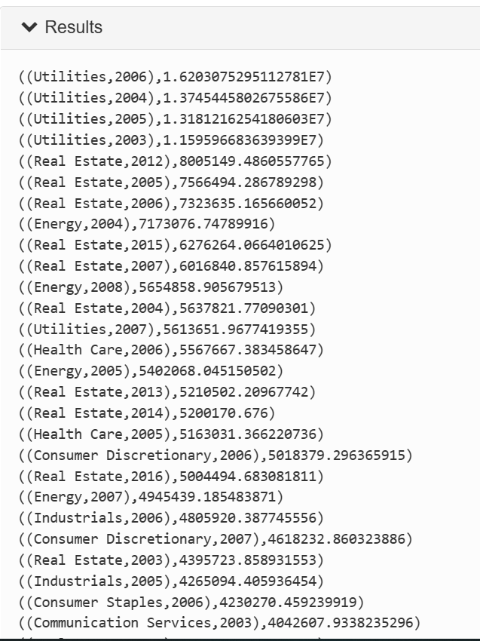
Q12: What is the average traded volume for each sector? Make sure to include the results for each year in the dataset.
--- Load the data and set the schema
data = load '/user/maria_dev/pig/tadawul/Tadawul_stocks_Prepro.csv'
using org.apache.pig.piggybank.storage.CSVExcelStorage(',', 'YES_MULTILINE', 'UNIX', 'SKIP_INPUT_HEADER') as
(symbol:int, name:chararray, trading_name:chararray, sector:chararray,date:chararray, open:float, high:float, low:float,
close:float, change:float, perc_Change:float, volume_traded:int, value_traded:int, no_trades:int, month:int, day:int, year:int);
--- Group by sector
group_sectors = group data by (sector, year);
-- Get the average volume trades for each sector in every year
average_volume = foreach group_sectors generate group, AVG(data.volume_traded) as average_tradings_volume;
--- Sort from highest to lowest
sorted_average_volume = order average_volume by average_tradings_volume desc;
--- Display the result
dump sorted_average_volume;

Slide 13
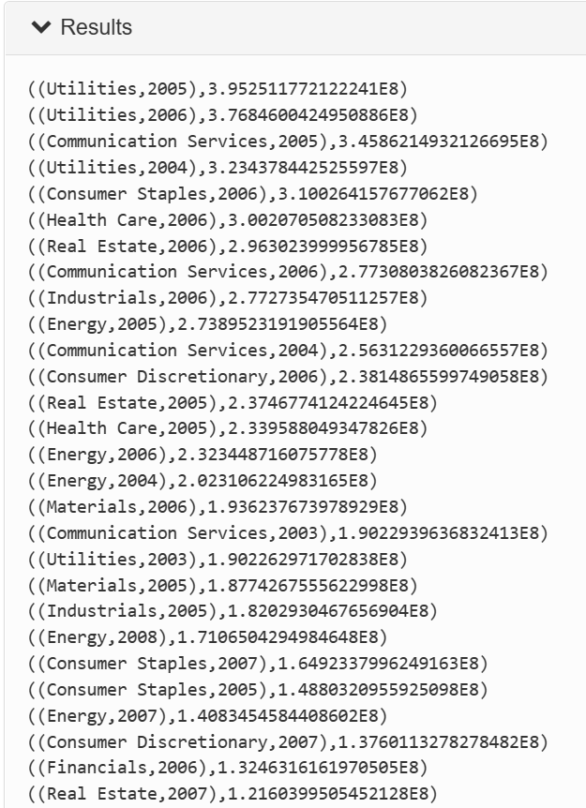
Q13:What is the average traded value for each sector? Make sure to include the results for each year in the dataset.
--- Load the data and set the schema
data = load '/user/maria_dev/pig/tadawul/Tadawul_stocks_Prepro.csv'
using org.apache.pig.piggybank.storage.CSVExcelStorage(',', 'YES_MULTILINE', 'UNIX', 'SKIP_INPUT_HEADER') as
(symbol:int, name:chararray, trading_name:chararray, sector:chararray,date:chararray, open:float, high:float, low:float,
close:float, change:float, perc_Change:float, volume_traded:int, value_traded:int, no_trades:int, month:int, day:int, year:int);
.
--- Group by sector
group_sectors = group data by (sector, year);
-- Get the average value trades for each sector in every year
average_value = foreach group_sectors generate group, AVG(data.value_traded) as average_tradings_value;
--- Sort from highest to lowest
sorted_average_value = order average_value by average_tradings_value desc;
--- Display the result
dump sorted_average_value;

Slide 14
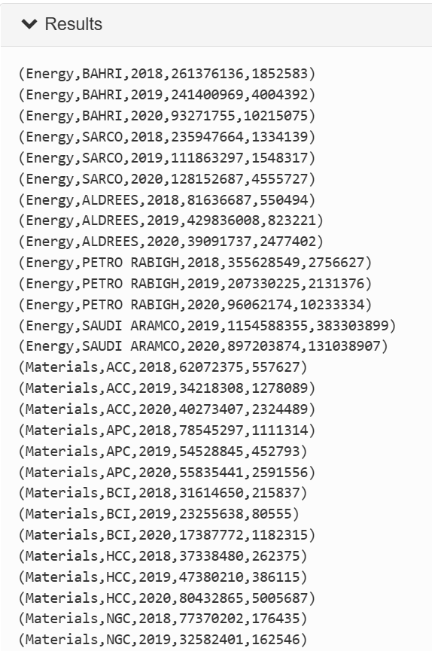
Q14:What is the highest and lowest value traded for companies in each sector from 2018 to 2020?
--- Load the data and set the schema
data = load '/user/maria_dev/pig/tadawul/Tadawul_stocks_Prepro.csv'
using org.apache.pig.piggybank.storage.CSVExcelStorage(',', 'YES_MULTILINE', 'UNIX', 'SKIP_INPUT_HEADER') as
(symbol:int, name:chararray, trading_name:chararray, sector:chararray,date:chararray, open:float, high:float, low:float,
close:float, change:float, perc_Change:float, volume_traded:int, value_traded:int, no_trades:int, month:int, day:int, year:int);
--- filter by year from 2018 to 2020
filter_data = FILTER data BY (year >= 2018) AND (year <=2020);
--- Group by sector,trading_name and year
group_sectors = group filter_data by (sector,trading_name,year) ;
-- Get the highest and lowest value traded
highest_lowest_value = foreach group_sectors generate FLATTEN(group) AS (sector,trading_name,year),
MAX(filter_data.value_traded) as highest_tradings_value,
MIN(filter_data.value_traded) as lowest_tradings_value;
--- Display the result
dump highest_lowest_value;

Slide 15
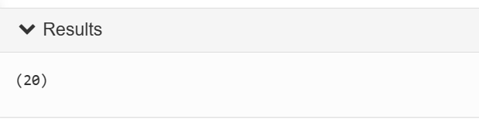
Q15: find count of companies lost more than fifty percent of the price of their shares (perc Change is greater than -50)
--- Load the data and set the schema
data = load '/user/maria_dev/pig/tadawul/Tadawul_stocks_Prepro.csv'
using org.apache.pig.piggybank.storage.CSVExcelStorage(',', 'YES_MULTILINE', 'UNIX', 'SKIP_INPUT_HEADER') as
(symbol:int, name:chararray, trading_name:chararray, sector:chararray,date:chararray, open:float, high:float, low:float,
close:float, change:float, perc_Change:float, volume_traded:int, value_traded:int, no_trades:int, month:int, day:int, year:int);
--- filter by perc_Change < -50
data_filter = FILTER data BY (perc_Change <-50); --
-- using DISTINCT
companies = FOREACH data_filter GENERATE trading_name;
uniq_companies = DISTINCT companies;
-- Grouping the data
grouped_companies = GROUP uniq_companies ALL;
-- find the count
uniq_companies_count = FOREACH grouped_companies GENERATE COUNT(uniq_companies.trading_name);
-- Display the results
DUMP uniq_companies_count;

Slide 16
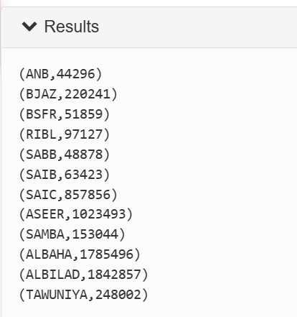
Q16: What is the total traded number for each company in the Financials sector of the year 2006?
--- Load the data and set the schema
data = load '/user/maria_dev/pig/tadawul/Tadawul_stocks_Prepro.csv'
using org.apache.pig.piggybank.storage.CSVExcelStorage(',', 'YES_MULTILINE', 'UNIX', 'SKIP_INPUT_HEADER') as
(symbol:int, name:chararray, trading_name:chararray, sector:chararray,date:chararray, open:float, high:float, low:float,
close:float, change:float, perc_Change:float, volume_traded:int, value_traded:int, no_trades:int, month:int, day:int, year:int);
-- filter by Financials sector and 2006 year
data_filter = FILTER data BY (sector == 'Financials') AND (year == 2006);
-- Group by trading name
group_trading_name = group data_filter BY trading_name;
-- Get the total no_trade for Financial ssector in 2006 year
SUM_no_trades = foreach group_trading_name generate group, SUM(data_filter.no_trades) as sum_no_trades;
--- Display the result
dump SUM_no_trades;

Slide 17
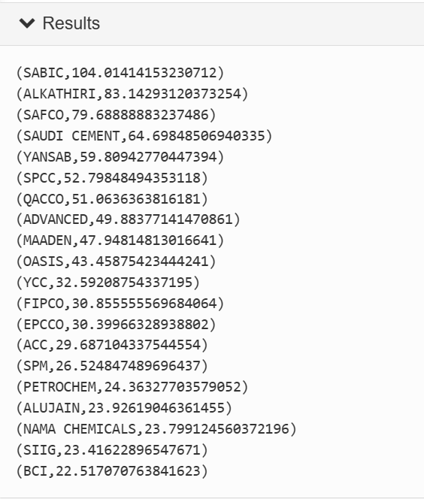
Q17: what is the average close price for the companies in Materials sector last 2 years in data set, find top 20 companies?.
--- Load the data and set the schema
data = load '/user/maria_dev/pig/tadawul/Tadawul_stocks_Prepro.csv'
using org.apache.pig.piggybank.storage.CSVExcelStorage(',', 'YES_MULTILINE', 'UNIX', 'SKIP_INPUT_HEADER') as
(symbol:int, name:chararray, trading_name:chararray, sector:chararray,date:chararray, open:float, high:float, low:float,
close:float, change:float, perc_Change:float, volume_traded:int, value_traded:int, no_trades:int, month:int, day:int, year:int);
-- filter data by Materials sector and year is more than 2019
data_filter = FILTER data BY (sector == 'Materials') AND (year >= 2019);
-- group by trading name
group_companies = group data_filter BY trading_name;
-- Get the averge close price
avg_of_close = foreach group_companies generate group , AVG(data_filter.close) as avg_close;
-- sorted from highest to lowest
sorted_avg_close = order avg_of_close by avg_close desc;
top_20 = limit sorted_avg_close 20;
-- Display the result
dump top_20;

Slide 18
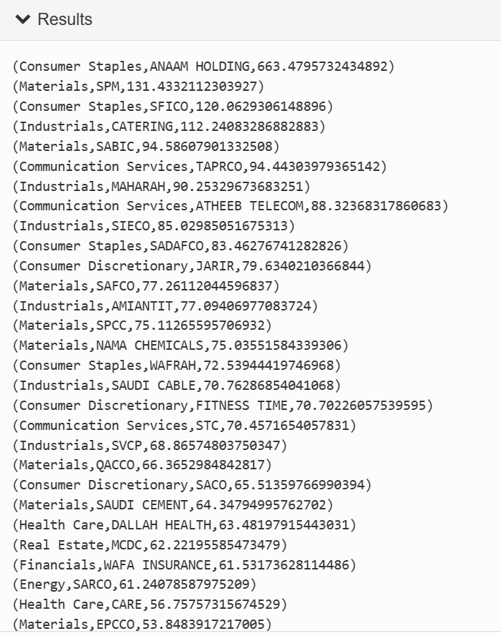
Q18: Find the average of high price of shares for companies in each sector, and sort them from highest to lowest
--- Load the data and set the schema
data = load '/user/maria_dev/pig/tadawul/Tadawul_stocks_Prepro.csv'
using org.apache.pig.piggybank.storage.CSVExcelStorage(',', 'YES_MULTILINE', 'UNIX', 'SKIP_INPUT_HEADER') as
(symbol:int, name:chararray, trading_name:chararray, sector:chararray,date:chararray, open:float, high:float, low:float,
close:float, change:float, perc_Change:float, volume_traded:int, value_traded:int, no_trades:int, month:int, day:int, year:int);
-- group by sector,trading_name
group_sectors_names = group data BY (sector,trading_name);
-- Get the average of high price of shares for companies in each secto
avg_of_high = foreach group_sectors_names generate FLATTEN(group) AS (sector,trading_name), AVG(data.high) as avg_highPricec;
-- sort average of high price desc
sorted_high_price = order avg_of_high by avg_highPricec desc;
--- Display the result
dump sorted_high_price;

Slide 19
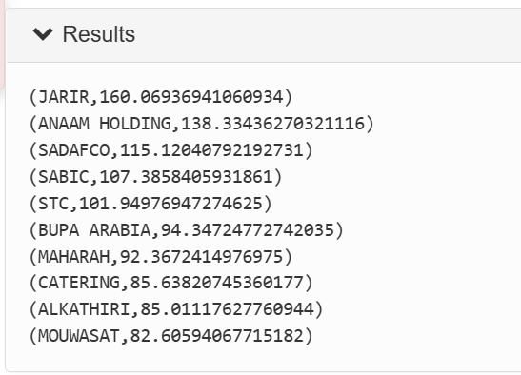
Q19: what is the top ten companies that their low price is less than open in year 2019.find the average of low price of shares for those companies in that year
--- Load the data and set the schema
data = load '/user/maria_dev/pig/tadawul/Tadawul_stocks_Prepro.csv'
using org.apache.pig.piggybank.storage.CSVExcelStorage(',', 'YES_MULTILINE', 'UNIX', 'SKIP_INPUT_HEADER') as
(symbol:int, name:chararray, trading_name:chararray, sector:chararray,date:chararray, open:float, high:float, low:float,
close:float, change:float, perc_Change:float, volume_traded:int, value_traded:int, no_trades:int, month:int, day:int, year:int);
--- filter by low less than open in year 2019
filter_data = FILTER data BY (low < open) AND (year ==2019);
--- Group by trading names
group_trading_name = group filter_data by trading_name;
-- Get the average of high price of shares for companies in each secto
avg_lowless_open = foreach group_trading_name generate group,
AVG(filter_data.low) AS avg_low;
--- Sort from highest to lowest
sorted_avg_lowless_open = order avg_lowless_open by avg_low desc;
--- Take the top 10 average
highest_avg_lowless_open = limit sorted_avg_lowless_open 10;
--- Display the result
dump highest_avg_lowless_open;

Slide 20
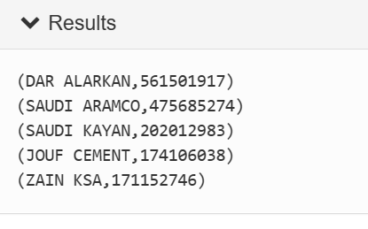
Q20: what is the total volume traded for the companies in 2020,sort from highest to lowest, limit to first 5 highest volume .
--- Load the data and set the schema
data = load '/user/maria_dev/pig/tadawul/Tadawul_stocks_Prepro.csv'
using org.apache.pig.piggybank.storage.CSVExcelStorage(',', 'YES_MULTILINE', 'UNIX', 'SKIP_INPUT_HEADER') as
(symbol:int, name:chararray, trading_name:chararray, sector:chararray,date:chararray, open:float, high:float, low:float,
close:float, change:float, perc_Change:float, volume_traded:int, value_traded:int, no_trades:int, month:int, day:int, year:int);
-- filter by year 2020
data_filter = FILTER data BY year == 2020;
-- group by trading_name
group_companies = group data_filter BY trading_name;
-- Get the total of volume
total_of_volume = foreach group_companies generate group, SUM(data_filter.volume_traded) as total_volume;
-- sorted from highest to lowest
sorted_total_volume = order total_of_volume by total_volume desc;
five_top = limit sorted_total_volume 5;
--- Display the result
dump five_top;

